Slide 1
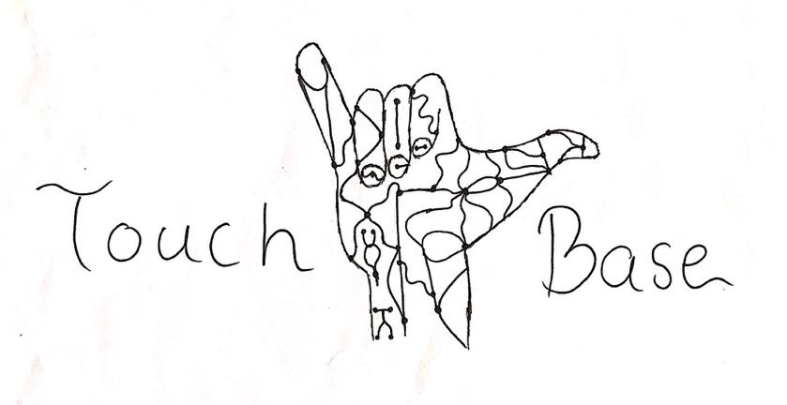
Touch Base:
Aseel Yousef, Lihua Diao
Xiaohan Liu, Ethan Gage

Slide 2
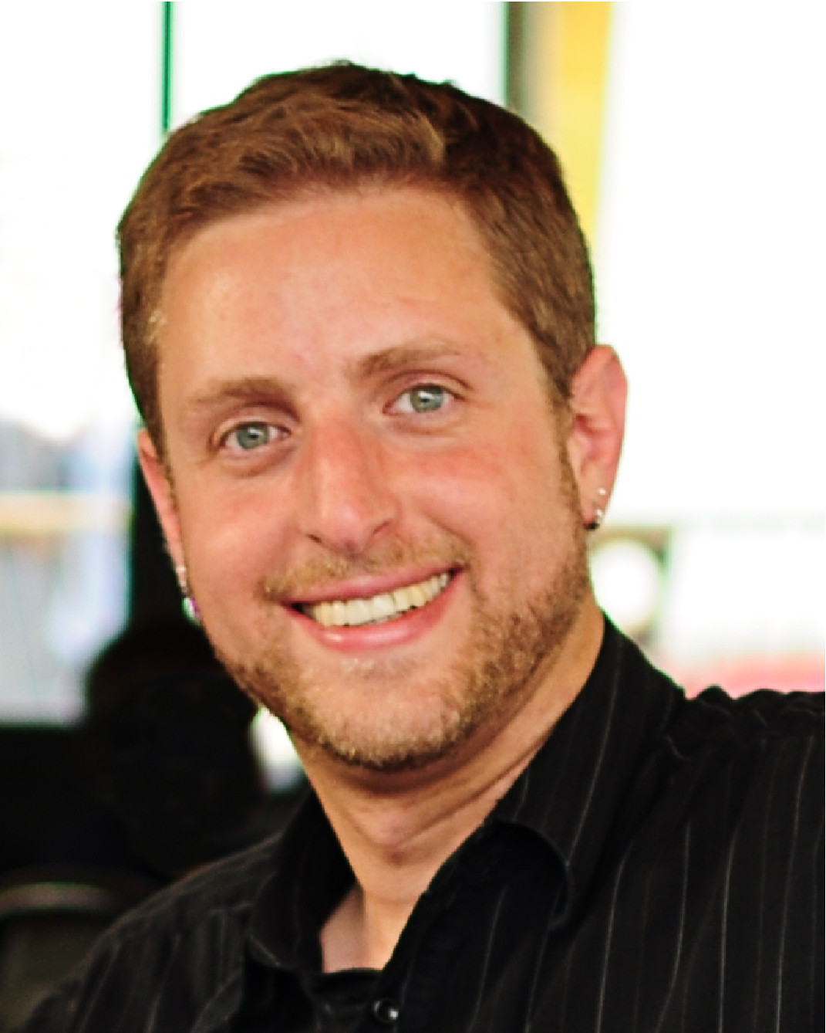
The Team
Client: Dr. Kyle Winfree
GTA mentor: Demetria Shepherd
Team members:
Aseel Yousef - Electrical Engineering
Lihua Diao - Electrical Engineering
Xiaohan Liu - Computer Engineering
Ethan Gage - Electrical Engineering
Collaboration: Mechanical Engineering Team
Aseel

Slide 3
Introduction
The project is Intended for the children of the Northern Arizona area, who have lost their sense of touch
The purpose of the project is enhancing and improving the capabilities of low-cost prosthetics
Adding electronic features such as pressure and haptic feedback
Rechargeable, long battery life
Making it an open source for future use
Aseel

Slide 4
Early Stages
Three subsystems:
Myosensor: Muscle Sensor - > Arduino -> Servos -> Four Fingres
Toe-To-Thumb: Transfer(lower): Sensor under the toe - > Arduino -> XBEE transfer Receive(upper): XBEE receiver-> Arduino -> servo -> Thumb
Touch: Pressure Sensor - > Arduino -> Servos -> Constricting band
Three prototypes:
Reading Muscle Data : Using MyoWare Sensor to test how much a given muscle is flexed.
Read Analog Sensor Data: Using pressure sensor to test pressure and display the data.
Control Servo Motor: Using Arduino button to control the rotation of the motor.
Xiaohan
Notes:
At the beginning of the project, we plan to add three main features to this prosthesis.
First, we have our myosensor subsystem which would allow the user to control four fingers of the prosthetic by flexing or relaxing their muscle.
Second, we have toe -to thumb subsystem which would allow the user to control thumb by toe .There is a pressure sensor under the toe, and the arduino and XBee transfer are on the shoes, the sensor can detect the pressure and send data to motor on the arm through Arduino, Xbee, Then the servo motor control the movement of thumb.
Third, In order to give sense of touch to our client, we plan to add pressure sensor on the hand and mount a constriction band encircling the user’s arm. The band will constrict or expand based on the grip. This is our Touch subsystem
Based on these three subsystems, we divided our project to three prototypes. First, reading ~~~
In last semester, we finished all prototypes.

Slide 5
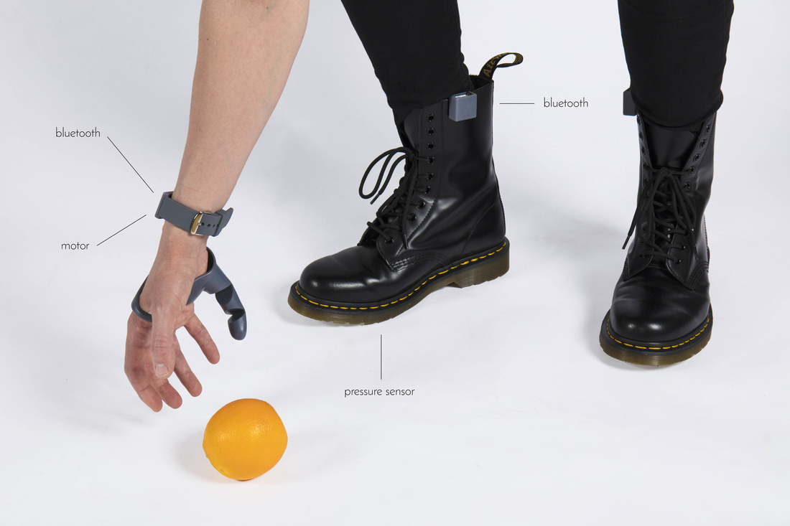
Early Stages Continued
Toe-To-Thumb: Additional Prototype
Started with Dani Clode Third-Thumb for control inspiration
Simple analog communication using XBee
Would be used for wireless control in the device.
Initially just to control thumb
Dani Clode - Third Thumb Project
Ethan

Slide 6
Project evolution
Improved:
Removed Myosensor subsystem
Changed the Toe - To - Thumb subsystem to Foot - To - Hand subsystem.
Added Haptic Feedback subsystem
Current three subsystems:
Foot - To - Hand subsystem: Using 5 sensors - 3 on dominant foot, 2 on recessive foot to control all five fingers.
Pressure Feedback subsystem: Detect grip through pressure sensor at the hand and control constricting band.
Haptic Feedback subsystem: Detect grip through pressure sensor at the hand and control vibration motor on the arm.
Xiaohan
Notes:
With the project progress, we adjusted some subsystems to make the prosthetics more suitable for our client. First, we carefully considered the physi ological constraints of children, they are too young and stilling growing, it is difficult to detect their muscles through muscle sensor. Besides, wearing a muscle sensor is a little complicated for children. Based on these reason, even though the subsystem was almost finished and worked well on teammates arm, we still removed Myosensor subsystem.
As a compensation, we changed ~ subsystem to ~ subsystem., which means using 5 sensors under the foot to control all figures, whether than using one sensor to control thumb.
Third, we added A secondary feedback system to enrich the sense of touch of the user. It has the same goal as Pressure Feedback subsystem.
So finally, we have three subsystems. The Foot~.
The pressure feedback subsystem, de~, Expanding bands indicate a loose grip. Constricting bands indicate a firm grip.
The Haptic feedback subsystem, ~, it allows to adjust vibration pattern and intensity.

Slide 7
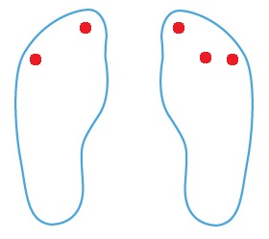
Foot-To-Hand Subsystem
This is the control system for the device.
2 transmitter modules, one on each foot, one with 2 sensors, one with 3 sensors and an arduino. One receiver module on redbot mainboard connected to five servos
Data originates from transmitter Xbee with 2 sensors. Reads sensor data transmits it to intermediate xbee at 50hz, intermediate arduino reads received data, reads its own sensor value, packages them together and transmits packet to receiver module xbee
Receiver Xbee unpacks the data, writes each sensor value to its corresponding servo.
Ethan

Slide 8
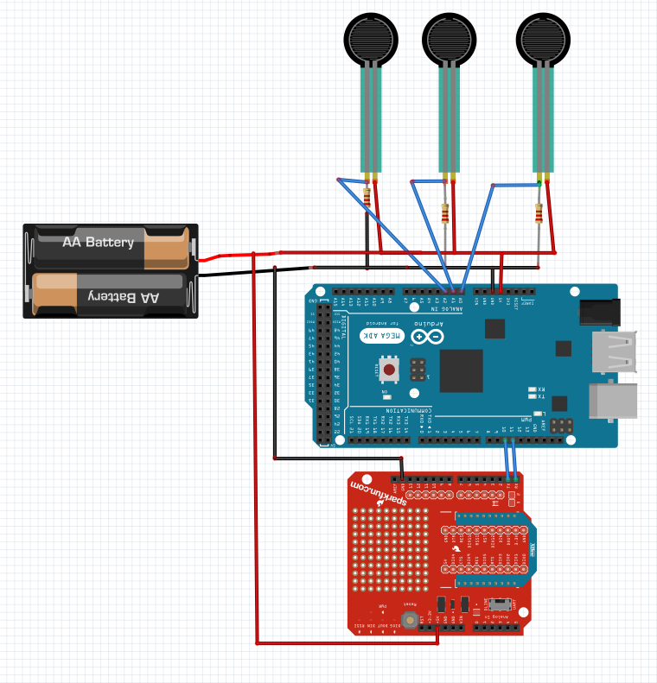
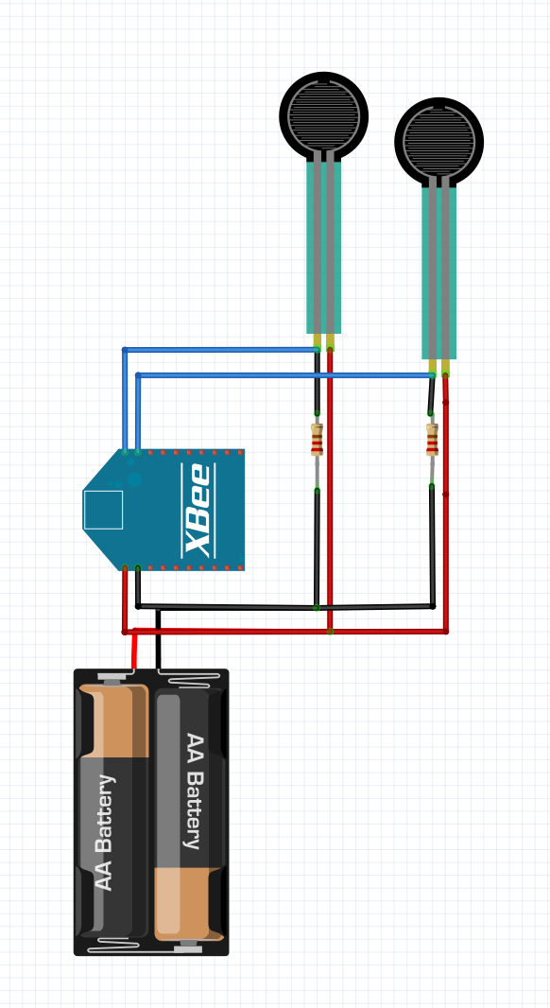
Transmitter 1
Transmitter 2
Send 2 sensor Values to Transmitter 2
Send 5 sensor Values to Receiver

Slide 9
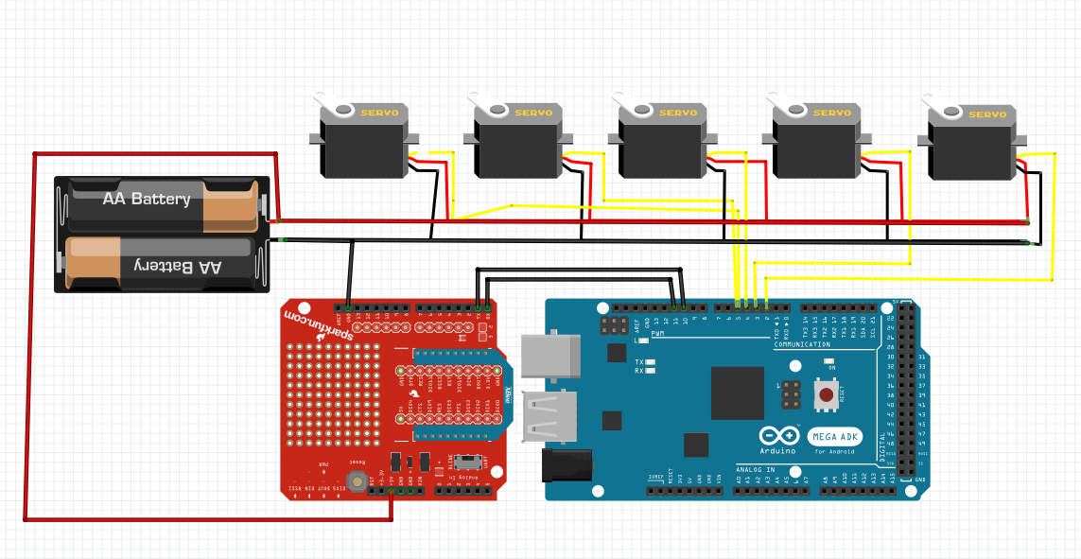
Receiver/ Motor Driver Circuit
Receive packet containing 5 sensor values -> Decode and map to 5 servos controlling hand
Not pictured: Sitting/standing switch

Slide 10
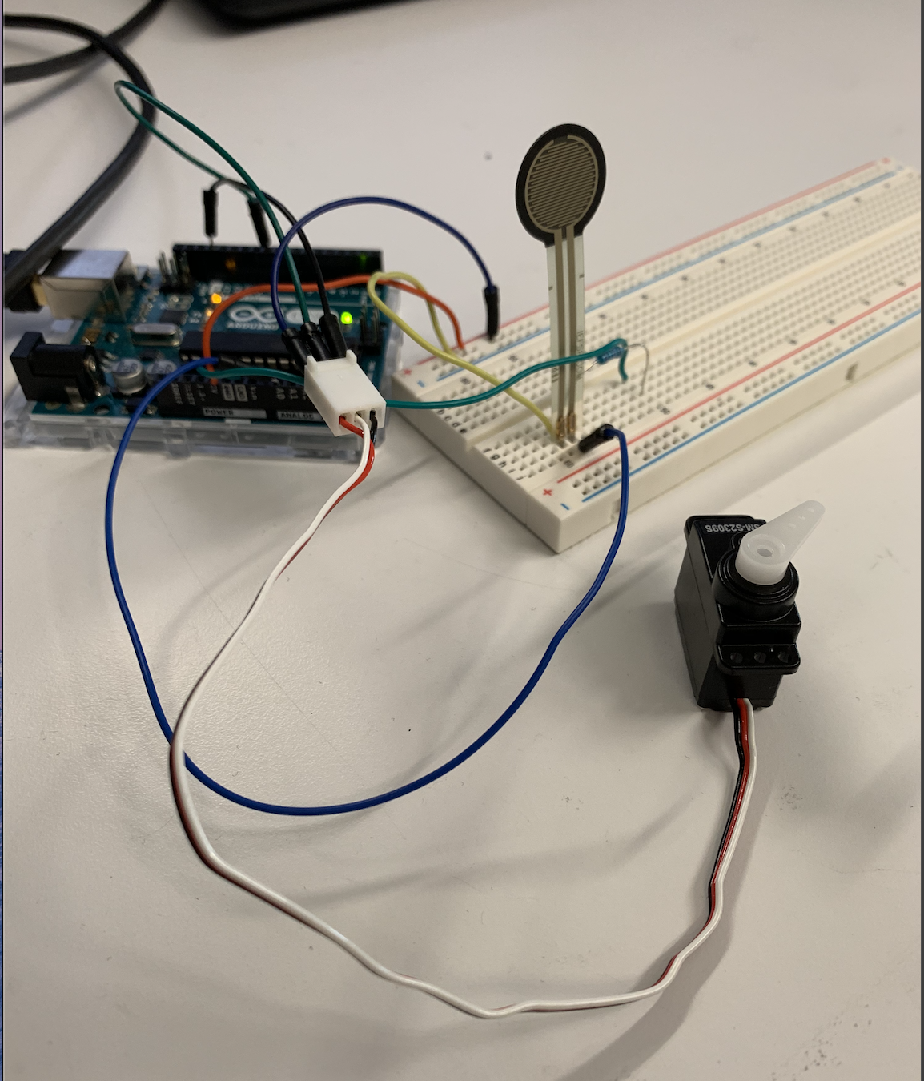
Pressure Feedback Subsystem
This system allows the user to recognize the amount of pressure being applied on objects
Setup:
Pressure Sensor is placed on the palm of the prosthetics
Pressure Sensor - > Arduino -> Servo motor
Servo motor connected to a constricting band, that is wrapped above the elbow
Servo motor control:
The band constricts indicating pressure that the pressure sensor reads
The band constricts when the pressure is high, and expand when the pressure is low
Aseel

Slide 11
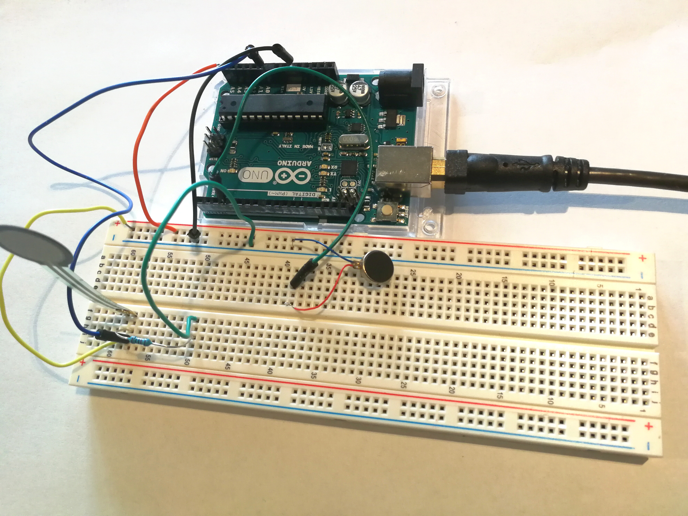
Haptic Feedback Subsystem
Function: let the user feel the sensation of touch
Method: vibration is one kind of haptic feedback
Principle: pressure generated by touch, pressure identification, recognized feedback command
Realize: Pressure sensor -> Arduino -> mini vibration motor
Lihua

Slide 12
Long - Term plans/ goals
Flagstaff e-nable chapter to continue updating arm.
Replace redbot mainboard with designed pcb
Open source code/design files
Utilize a third arduino to speed up communication rate
Increase number of sensors in the hand to increase number of usable vibration modules.
Program an array of vibration patterns to give more usable feedback to user.
Wrist hardware/software
More complex coding to allow for more operation modes.
Ethan

Slide 13
Conclusion
We have successfully completed our subsystems
Three subsystems work together
Foot-To-Hand for fingers control
Pressure feedback for band control
Haptic feedback for vibration motor control
Our project meets the client requirements
Our project still has potential because it is an open source
Lihua

Slide 14
Thank you

